Slide 1
Grandma’s Cookbook
Phase 2 Presentation

Slide 2
Phase 2 Summary

Slide 3
Work Done in Phase 2
Completion and finalization of front end framework
Initial UI/UX design implementation
Research and initial development of back end database
Mapping of Erd to readable diagram

Slide 4
Phase 2 Front End Development

Slide 5
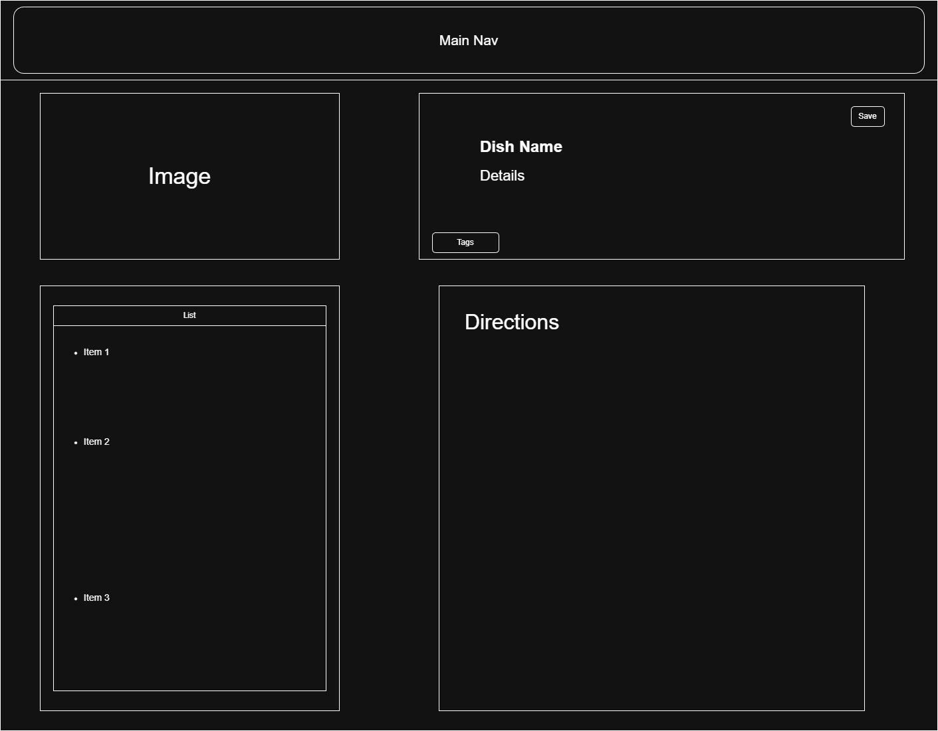
Initial Design
The front end was developed using the Quasar CSS framework, which allowed for wide access to a range of design components and easy translation of the initial UI to a functional front end.
Design schematics are as shown, prioritizing easy access to commonly used elements and proper hierarchy of elements:

Slide 6
Front End Design Process
Beginning
Research similar sites
What is popular
Framework
Endoskeleton
Logo
Cozy
Middle
Color scheme
Home vibes
Light Colors
Typography
More detail
Buttons
dropdowns
End
Testing colors
Implementing styles
Making sure there is space
Blended
Making every page show up in the same style

Slide 7
Database System

Slide 8
Requirements of database
Support for SQL database
The application will require certain traits from the database system used to serve and store app data.
Requires relationship support between entities such as users and their recipes
Support for storing structured data to enable filtering and searching of recipes
Supports cascading deletion and update for recipes and its ingredients
Given the requirements, a relational database management system (RDBMS) is chosen for the following:
Support for complex queries
Built-in support for data field constraints
Cascading operations to prevent issues such as orphan shopping lists
Due to additional properties including ACID compliance, the app will use MySQL to fulfil its data handling needs

Slide 9
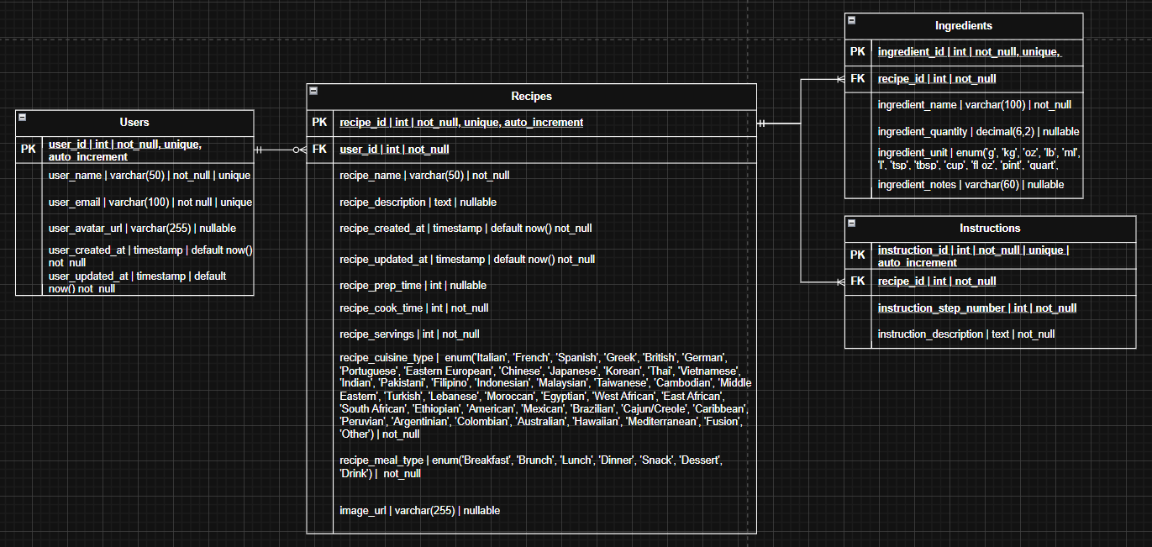
ERD diagram

Slide 10
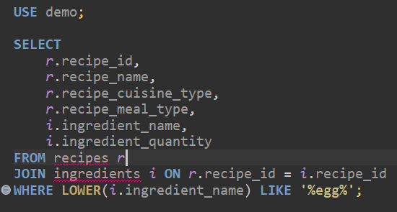
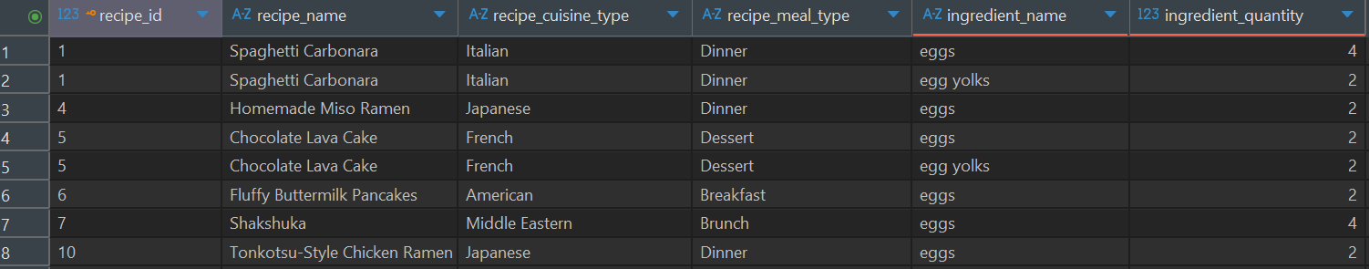
Demo Query
Fetching all recipes using eggs

Slide 11
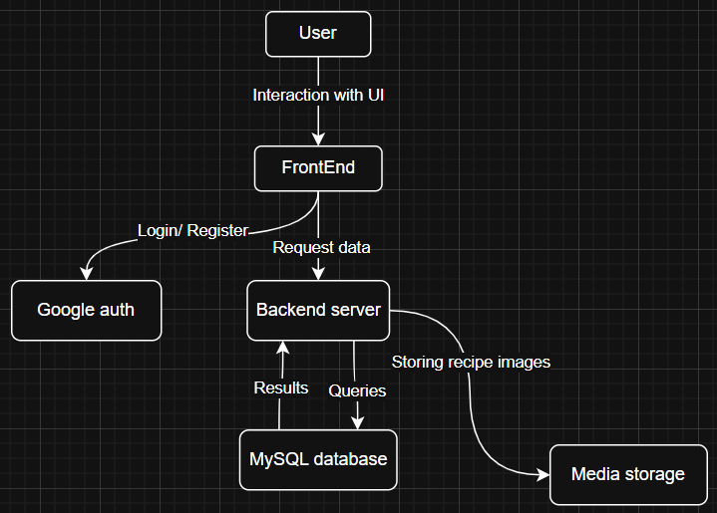
Data flow diagram

Slide 12
Phase 3 Initial Plans
Phase three will focus on bug testing of the front end systems and development of the back end databases and infrastructure.
Extensive bug testing will take place until roughly midway through phase three’s timeline in preparation for full stack implementation
Back end server architecture will be established using MySQL. This will include databases for storing account details and recipe information, as well as infrastructure for user querying and account encryption via the RSA Algorithm

